Slide 1
Quote of the month:
“It’s important to the sustainability of the Boy Scouts of America for us to provide a quality Scouting experience at all levels...”
Wayne Brock, CSE
Notes:
It’s important to the sustainability of the Boy Scouts of America for us to provide a quality Scouting experience at all levels,
and that’s why I’m excited to see that Councils across the country are focusing on innovative recruitment techniques to bring the fun, valuable lessons and fellowship that Scouting provides to a wider group of youth.

Slide 3
Youth Recruitment – OUR SURVIVAL!
Treasure Hunt
Critter Race
Fishing Derby
Kite Derby
Rocket Academy
S’mores Party
Craft Fair
scouting.org/Membership/Youth_Recruitment/Events
Notes:
90%+ become Boy Scouts
Cub Scout Financial Driver of Local Council
Treasure Hunt
Critter Race
Fishing Derby
Kite Derby
Rocket Academy
S’mores Party
Craft Fair

Slide 4
Youth Retention – OUR JOB!
Handbook for All Cub Scouts
First Den Meeting Within 7 Days
Earn/Receive Bobcat Rank 60 Days
Frequent Communication to Parents
Den Chief for Every Den
Select, Orient and Train
Annual Unit Program Plan
Notes:
90%+ become Boy Scouts
Cub Scout Financial Driver of Local Council
Only 45% get a handbook – uniform & book = excite & engage kids
Kids left within 7 to 10 days of joining because they weren’t contacted by Den Leader (use onboarding envelope)
Bobcat Rank = immediate recognition they stay longer
Communication! Easy to use tools in Cub Scout section… templates (weekly den meetings)
Den Chief – indicator of WTS transition
Leader represents 8-10 boys. They determine the quality of program experience.
Annual plan = stronger, better Den Meetings/Pack Program!

Slide 5
COMMISSIONER Training Updates

Slide 6
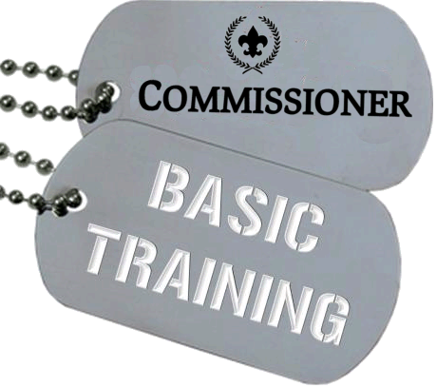
• October 12, 2013 – Sponsored by A4 8:30 AM @ Pittsburgh Office
December 14 – Sponsored by Area 2

Slide 7
NEW!!!
ADC for Recruitment Training
Tuesday, November 12 7:00 PM @ Flag Plaza

Slide 8
Commissioner Training Nov 19 @ 6 PM

Slide 9
Commissioner Christmas
Notes:
Don’t Miss This!

Slide 10
• March 15, 2014 @ IUP Includes DLC/Commissioner College
Bob Reese representing Commissioners
Notes:
SLTC – March 15, 2014

Slide 11
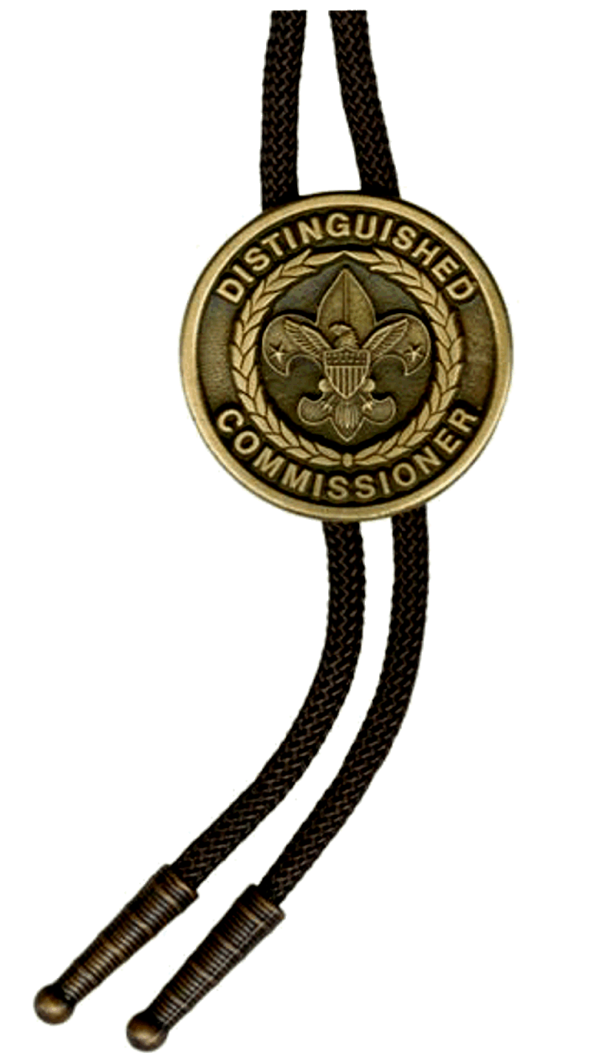
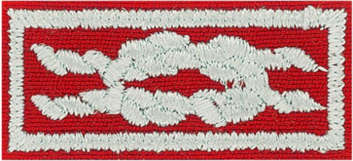
D.C.S.A.
Distinguished Commissioner Service Award
dcsa.commissioner-bsa.org
Notes:
Commissioner Award of Excellence in Unit Service

Slide 12
Commissioner Award of Excellence in Unit Service
Why wasn’t it available until May 2013?
What is the purpose?
Who will be first in LHC?
scouting.org/Commissioners/recognition
Notes:
Commissioner Award of Excellence in Unit Service
The award knot has not been available as its requirements are intended to be completed over the course of two consecutive years. Also, one of the requirements was participation in or staffing of one continuing education event for commissioner service and credit cannot be given for service prior to the date the award was introduced. First available May 1, 2013.
Commissioners must complete a number of retention-based tasks, projects, and training requirements over a period of at least two consecutive year

Slide 13
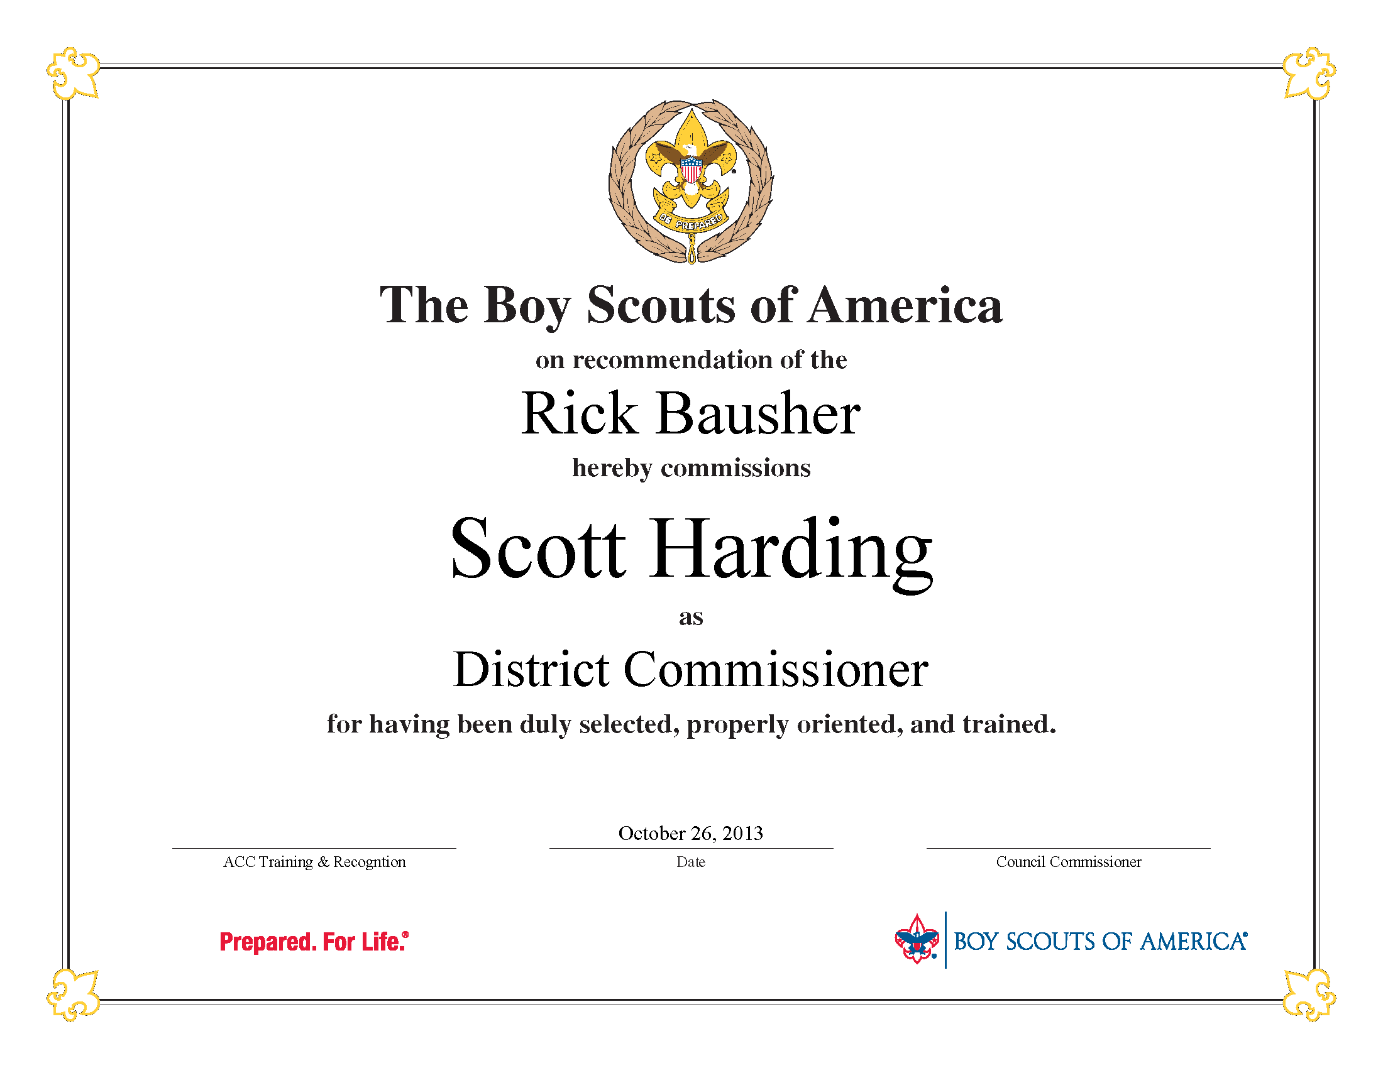
NEWS You Can USE
FREE Commissioning Certificate
scouting.org/Commissioners/recognition

Slide 14
Planning Ahead…
Commissioner Service for Non-Traditional or Faith Based Units
The Council Commissioner
District Commissioner and Assistant DC Training
Effective Roundtables
How to Conduct a Commissioner College
Putting More Outing in Scouting
The Unit Commissioner
Week 2: June 15-21 - Commissioner Week

